Slide 1
What are the barriers to cervical screening?
Kathryn Finnin– Cancer Screening and Awareness Coordinator, Cancer Wise Leeds

Slide 2
Background, Research & Context
Key Points:
The UK Government’s Lesbian, Gay, Bisexual & Transgender (LGBT) Survey (2017) highlighted a number of concerns around the way the Transgender and/or Non-Binary community feel about accessing health care in this country.
18% of Transgender survey respondents said they avoided healthcare treatment for fear of discrimination or intolerant reactions.
Evidence suggests that Transgender Men and/or Non-Binary people, with a cervix, have lower odds of lifetime and up-to-date cervical screening uptake (Alison Berner, ‘Attitudes of Transgender Men and Non-Binary people to Cervical Screening’ - 2020).
National LGBT Survey: Summary report - GOV.UK (www.gov.uk)
Key Terminology:
A Transgender person has a gender identity or gender expression that differs from the sex they were assigned at birth.
A Transgender (Trans) Man is a term used to describe someone who was assigned female at birth but identifies and lives as a man.
Non-Binary is an umbrella term for people whose gender identity does not sit comfortably with ‘man’ or ‘woman’.
Cisgender is a term used for people whose gender identity matches their sex assigned at birth.

Slide 3
Findings - Barriers to Cervical Screening
It is the responsibility of the GP or Health Care Team to organise access to cervical screenings and ensure fail safe systems are in place for Transgender Men and/or Non-Binary people with a cervix.
Some known & noted barriers:
Invitations
Disclosure
Expecting and / or receiving negative or inappropriate reactions (including misgendering)
Dysphoria
Testosterone Replacement Therapy effects
Sample processing errors
Key Terminology:
Microaggressions – brief and commonplace verbal, behavioural or environmental indignities, whether intentional or unintentional, that communicates hostile, derogatory or negative prejudicial slights and insults towards any marginalised group.

Slide 4
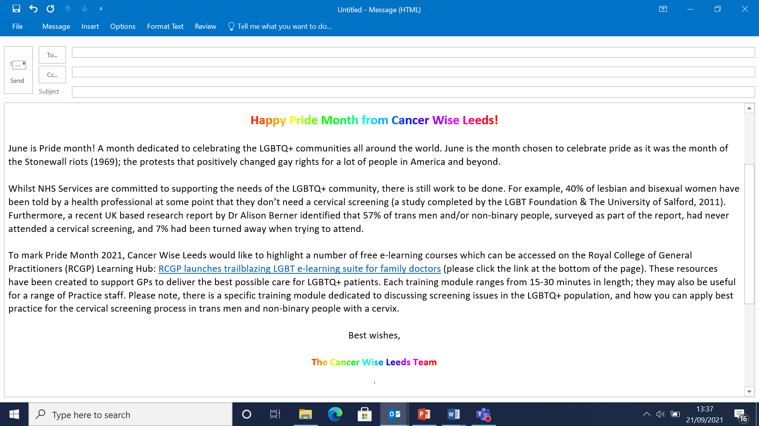
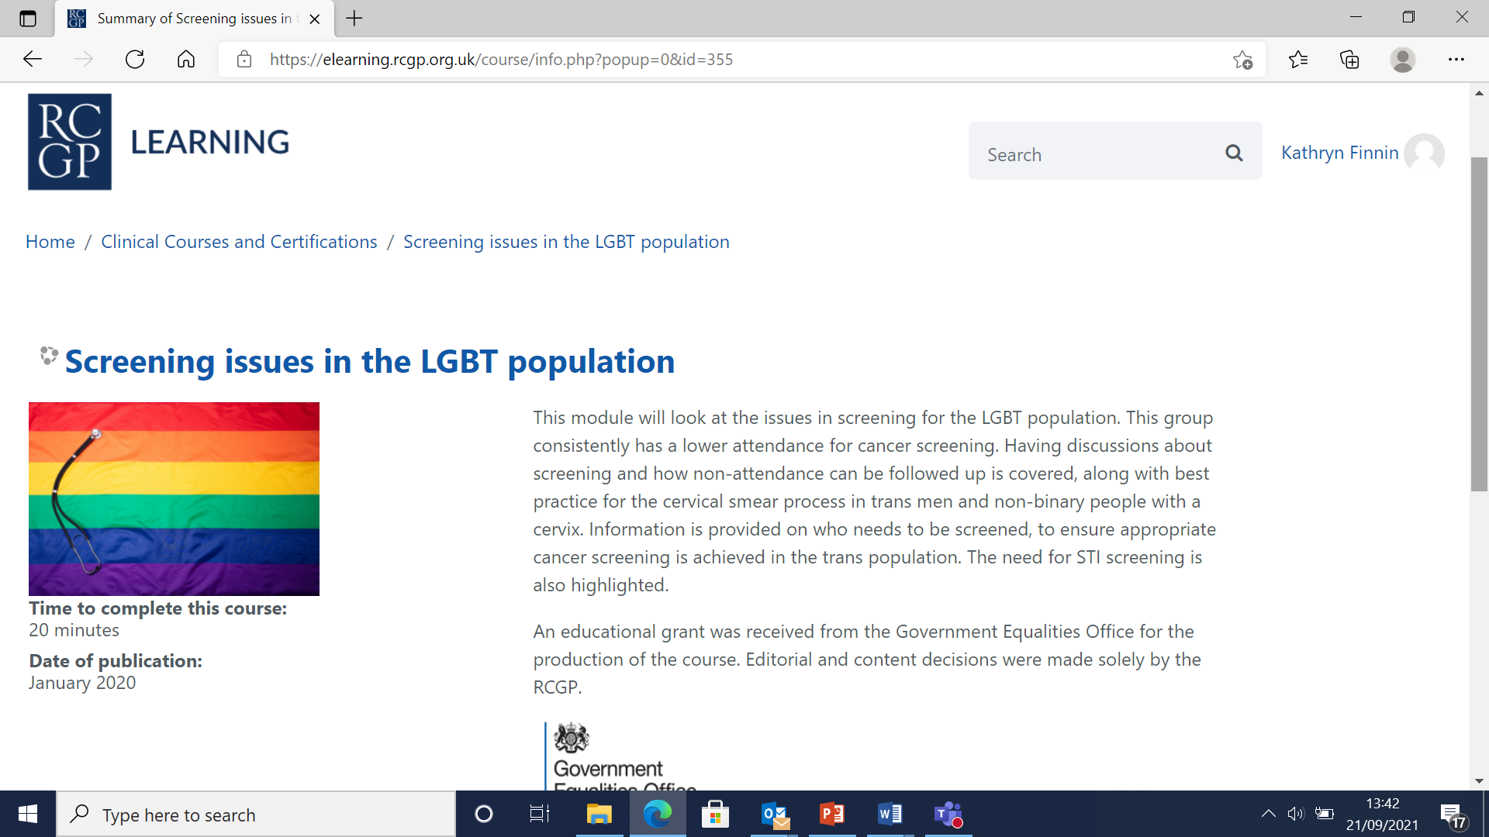
Actions so far…
“The training was…accessible, informative and will hopefully support change…”

Slide 5
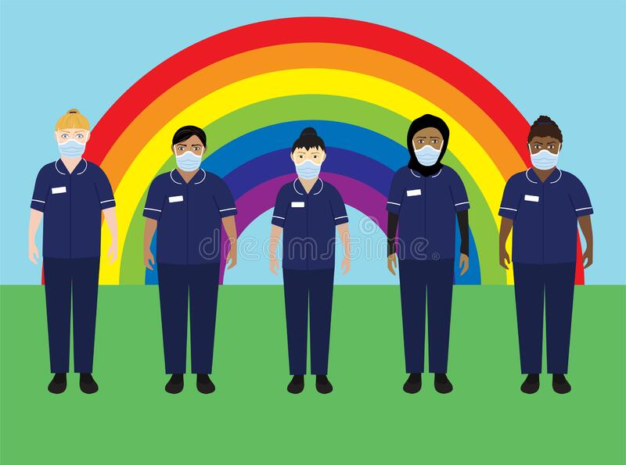
Recommendations / Next Steps
Key Points:
Awareness and education will continue to be key;
January 2022 – Cervical Cancer Awareness Week
March 2022 – The International Transgender Day of Visibility
Guidance document for Primary Care professionals;
Informative
Practical
Supportive
Sustainable

