Slide 1
Call For A Kit Clinic Pilot
By Zobi Barok

Slide 2
Call for Kit Model
Lancashire Adopted a health visiting approach: recognition that face to face interventions has greatest impact
Blackpool, Blackburn and Darwen – lowest coverage areas (21% lowest)
CFAKC
Successful in engaging non responders with screening,
Increased practices’ coverage rate
Increased the knowledge of bowel screening among practice staff who could then support patients on an ongoing basis
Notes:
Initial project was set up with one male and one female worker
Blackpool, Blackburn and Darwen – lowest coverage areas (21% lowest)
5 years later there are 4 community engagement office

Slide 3
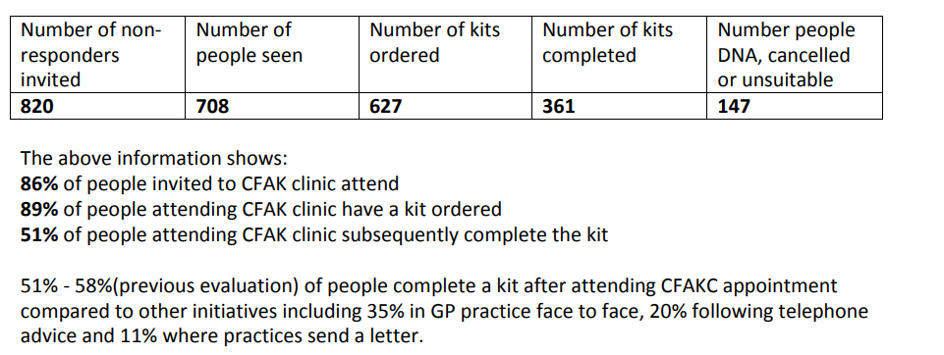
Results:

Slide 4
Why we are doing the pilot?
To increase bowel screening uptake using a person centred approach
Recognition that surgeries are putting time, energy and effort into increasing their bowel screening figures
To explore a new approach that to further break down barriers to participation in low bowel screening uptake areas.
Burmantofts, Harehills and Richmond Hill Primary Care Network was selected for this pilot.

Slide 5
The Pilot:
Launched in June 2021.
Each practice will be run two cohorts of the pilot which will be monitored.
Admin task
Use Non Responder lists to send out letters to cohort
Send out
easy read letters/texts
Use template to record that letter has been sent to patient.
Week One
½ day
Champion checks to see if any appointments have been made using NR list from previous week
Call up patients that letters have been sent to
Make 15 min appointments
2 attempts made.
Text patients who don’t pick up to ring surgery to make appointment
Use logs and template to record contact
Email logs with patient details deleted.
Week Two
½ day
Patient attends clinic
Telephone Consultation
DNAs
Kit ordered
Bag of resources given to patient
Patient & champion evaluation
Use log and template to update patient records
Email with patient details deleted.
Week Three
Full day
Notes:
Not needed but maybe info on Call to Kit?

Slide 6
Results:
Surgeries | No. of non responders contacted | No. of successful telephone Interventions | Numbers seen | No. of kits ordered | No. of kits completed
Practice A
Cohort 1 | 35 | 10 | 0 | 3 | 2
Cohort 2 | 40 | 20 | 0 | 12 | 13 week wait
Telephone Interventions best suited
Lack of Awareness evident
Bilingual conversation felt personalised
Second cohort more confident

