Slide 1
Barriers to cervical screening for 'first timers' (patients aged 25 – 29)
Kenyetta Cohen – Cancer Screening and Awareness Coordinator
Cancer Wise Leeds

Slide 2
Background
In the UK, females and people with a cervix are invited for cervical screening (a smear test) from age 25 until age 64.
It was identified that within certain postcode areas of East Leeds (LS8, LS9, LS14 and LS15) there is a high non-participation of cervical screening amongst patients age 25 – 29 i.e. 'first timers'.
Cancer Wise Leeds (CWL) asked Leeds Cancer Awareness Project (LCAP) to recruit and facilitate 3 focus groups to gain an insight into the reasons why people may not attend cervical screening in these areas and what can be done to help support people to attend.

Slide 3
Aim & Objectives
To determine the different views, barriers and motivating factors to cervical screening amongst eligible populations.
To understand what messages and support are needed to overcome barriers and drive behavioural change for the target audience.
To find the best methods to deliver messages and the most effective way for people to notice these messages.

Slide 4
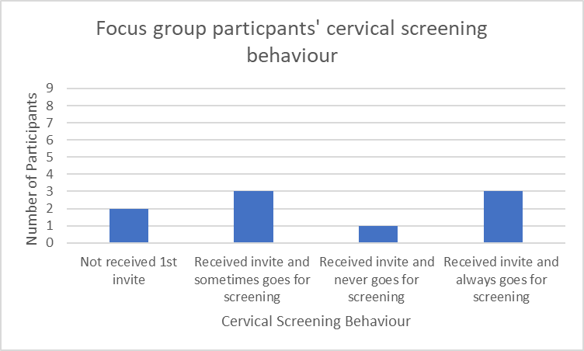
Findings
LCAP analysed the findings and produced the report.
Participants who actually attended the focus groups were on average age 25 years - 6 were White British and 3 were Pakistani.
Focus group participants' cervical screening behaviour
Most of the participants had either received their screening invitation and sometimes attend or always attend.
Two participants were yet to be invited (pre-25 / still aged 24).
One participant never attends their cervical screening invitation.

Slide 5
Findings
The focus groups highlighted some similarities and themes including:
Many know that the earlier cancer is detected the better and this motivates people to attend screening
Include a leaflet in the letter sent out
Raise awareness about screening by, looking at overall cervix health and not just looking for cancer
Social media campaign targeting platforms that younger age groups use
Reduce language and jargon barriers
Use videos and more engaging information
Lack of appointment availability is a barrier
Use real life stories / experiences

Slide 6
Findings
Six stakeholder interviews also took place. Participants included a practice nurse, a practice receptionist, a manager from Live Well Leeds, a youth work manager, a representative from Women's Health Matters and a representative from Getaway Girls.
The stakeholder interviews showed similarities including:
First timers may put off screening due to not knowing what actually happens
Recruit champions from different communities to raise awareness within their community
Those with children are less likely to fear screening and more likely to attend
Messages and appointment reminders sent electronically e.g. text or email
Reduce the stigma; normalise screening and talking about it
Use social media messages

Slide 7
Evaluation
Strengths of research:
At the time of this report, (May/Jun 2021) this was the only cervical screening insight work relating to 'first timers' happening in Leeds.
Good use of partnership working across the city.
The research will go on to inform targeted campaigns which are hoped will contribute to an increase in cervical screening uptake.
Limitations of research:
Small sample size.
Cannot assume views are unanimous across postcodes and the city.
Some participants were more dominant in conversation than others.

Slide 8
Recommendations
Develop social media comms materials/plan targeted at raising cervical screening awareness in first timers age bracket (24 – 29).
Many reported being told about cervical screening in high school, but not really understanding much about it at the time.
Much time passes between having the HPV (Human Papillomavirus) vaccination at 12/13 years old to being invited for the first screening.
Opportunity to use social media platforms popular with this age group (e.g. Facebook; Instagram) to do targeted awareness raising.
Focus on where cervical screening uptake tends to be lower e.g. postcode areas with higher levels of deprivation or high Black Asian & Minority Ethnic (BAME) populations.

Slide 9
Recommendations
Explore feasibility of GP sent comms materials for target audience
Mixed feedback about the use of letters (with a leaflet) and text messaging, but participants highlighted the benefits of both approaches.
Useful to have a suite of resources that cover all angles.
Targeted GP sent comms: valuable to involve target audiences in the development process.
Improve appointment accessibility
Comments on Facebook highlighted that on several occasions, patients faced barriers with accessibility of appointments.
Practices and PCNs should look to overcome such practical barriers.
Interest in weekend, evening and drop-in clinics; preference for appointments at patients' own practice.

Slide 10
Conclusion
There are multiple reasons why women and people with a cervix aged 24 – 29 do not attend cervical screening.
From the focus groups it is evident that more awareness is needed to help people understand what will happen at screening, but also to normalise screening and reduce stigma.
To do this targeted communications will be developed within timeframe of the Cancer Wise Leeds programme.

Slide 11
Next Steps
Cancer Wise Leeds is addressing these themes and barriers as follows:
Use real life stories / experiences
Raise awareness about screening by, looking at overall cervix health and not just looking for cancer
Reduce language and jargon
Use videos and more engaging information
CWL is continuing to review and develop
specific wording on
letter templates,
that can be used
by practices
CWL have produced videos explaining what happens at a cervical screening, in English, Polish & Urdu.
CWL to produce an informal video aimed at first timers to educate re HPV & overall cervix health.
First timers may put off screening due to not knowing what actually happens
Include a leaflet in the letter sent out
Reduce the stigma; normalise screening and talking about it

Slide 12
Next Steps
Cancer Wise Leeds is addressing these themes and barriers as follows:
Social media campaign targeting platforms that younger age groups use
Lack of appointment availability is a barrier
Messages and appointment reminders sent electronically e.g. text or email
Use social media messages
CWL looking into the options practices have to use online appointment booking systems
CWL is looking at developing specific wording for text messaging templates, which practices can use
CWL is working with Extended Access to
create more clinics and improve appointment availability
CWL supporting practices to create a social media presence and to use such platforms to convey messages; engage with patients; put patients more at ease
CWL share content with practices that can be used on their website & on social media
Reduce the stigma; normalise screening and talking about it

