Slide 1
Bowel Screening Template
Catherine McDonald

Slide 2
In a patient record

Slide 3
Blue Dot Homepage

Slide 4
Nurse Tab

Slide 10
PRE 60 LETTER

Slide 14
EASY READ PRE 60 LETTER

Slide 15
CONTACT METHOD

Slide 16
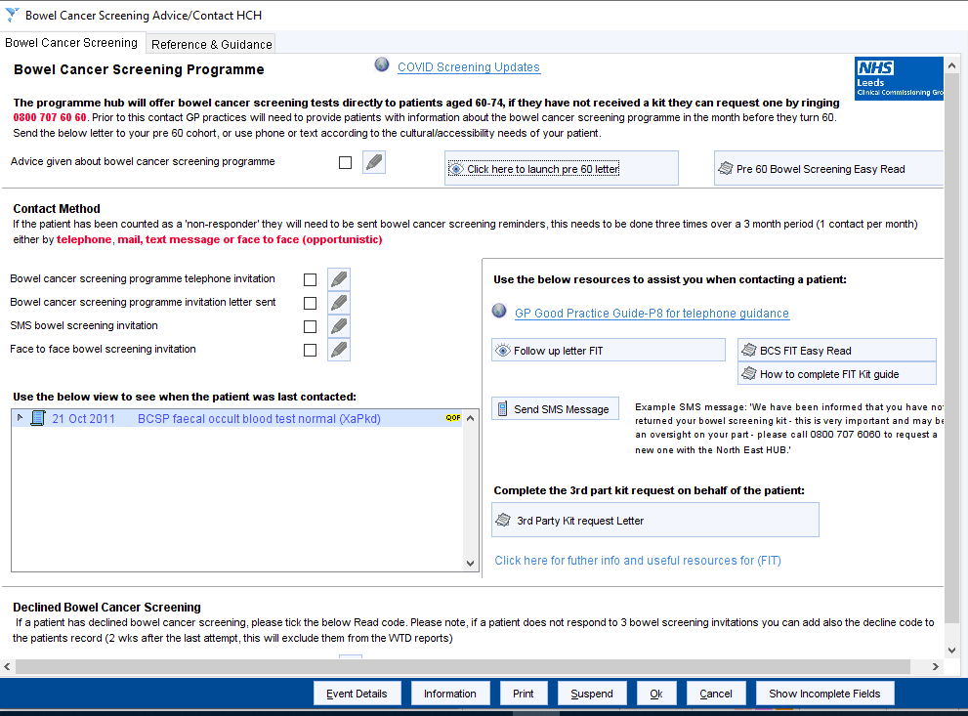
VIEW

Slide 17
RESOURCES

Slide 18
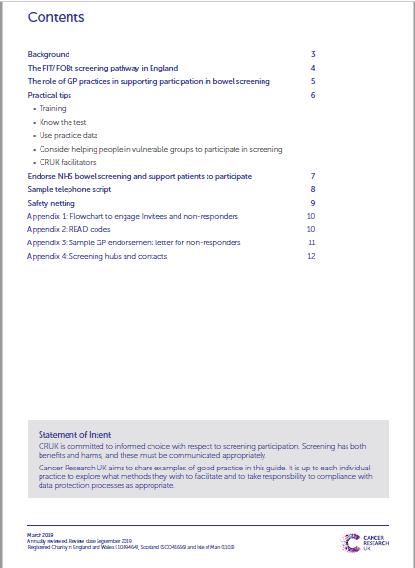

Slide 19
RESOURCES

Slide 20
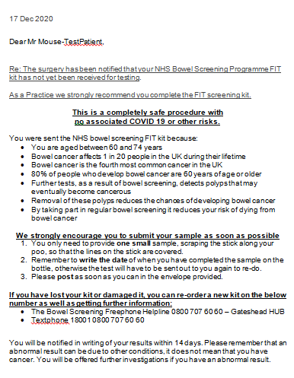
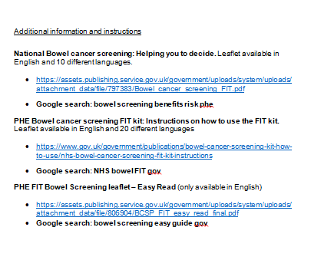

Slide 21
RESOURCES

Slide 22
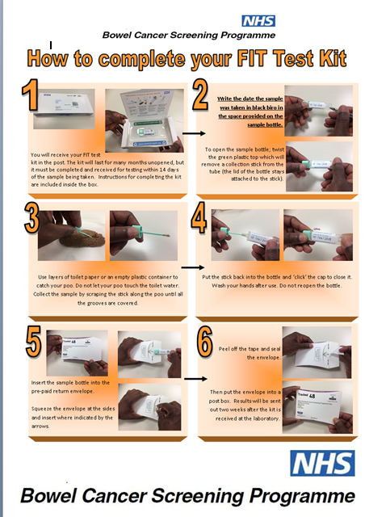

Slide 23
RESOURCES

Slide 24
User Pre-sets

Slide 25
User Pre-sets

Slide 26
User Pre-sets

Slide 27
User Pre-sets

Slide 28
User Pre-sets

Slide 29
RESOURCES

Slide 32
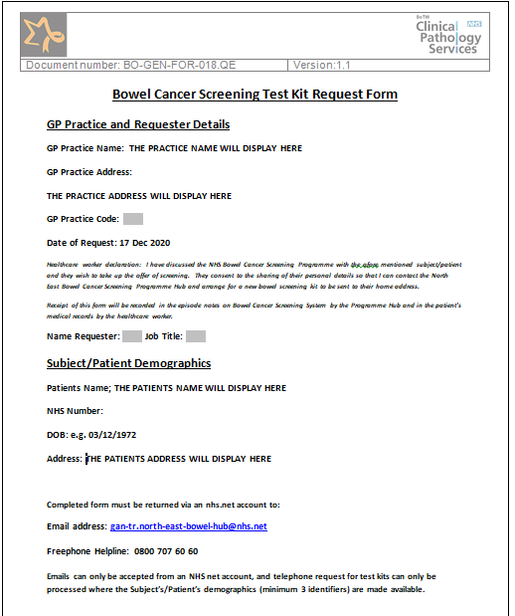

Slide 34
Reference guides

