Slide 1
Recording Screening Champion Activity
Tom Daniels- September 2022

Slide 2
Screening Champion Activity
Annual investment in Primary Care Screening Champions is £100k
Data collection is currently patchy- this must now improve
A lot of great work is being done, but it is not being recognised
Important to be able to demonstrate the crucial role that the Champions play
Data will be used to highlight and share best practice- how will we know what works well?
Screening data and champion activity can be shared within PCNs to identify learning and areas for focus
We will take a supportive approach and work closely with practices who need additional input
The following slides identify the key, minimum fields to be completed on the cervical and bowel templates
Body content

Slide 3
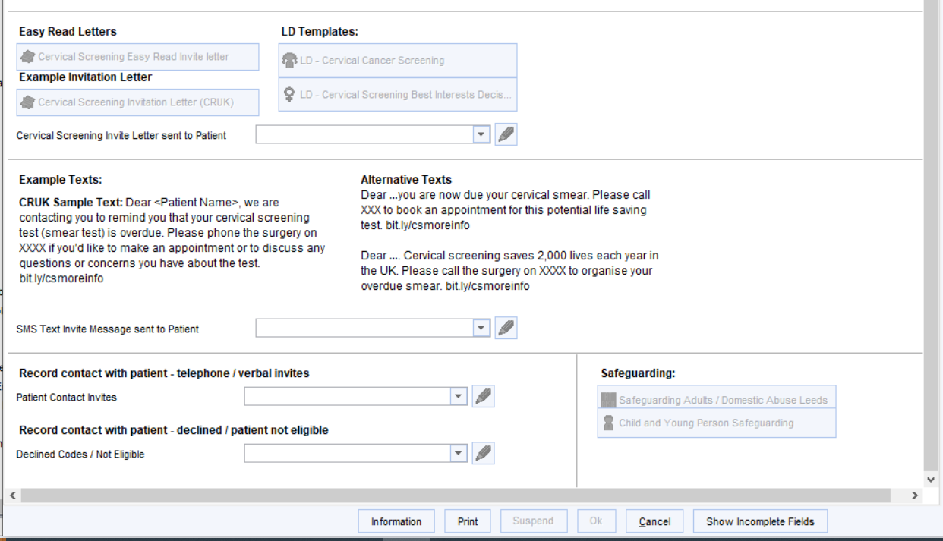
Cervical Screening Template- Key Fields

Slide 4
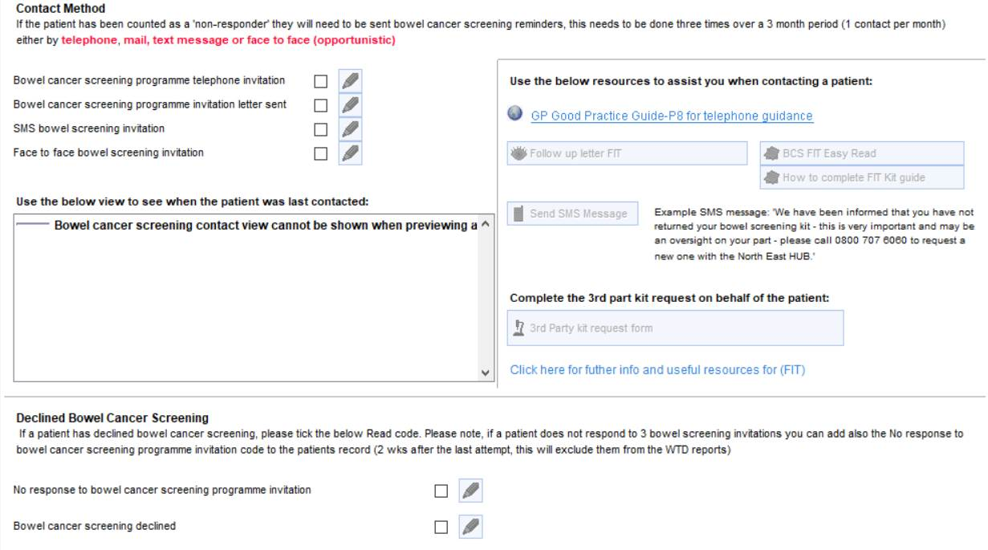
Bowel Screening Template- Key Fields

Slide 5
Tom Daniels

