Slide 1
Utilising out of hours extended access times for cervical screening – learning from pilot scheme
Lisa Hammond – Lead Cancer Screening and Awareness Coordinator, Cancer Wise Leeds
&
Alex Cocker – Cancer Screening and Awareness Coordinator , Cancer Wise Leeds

Slide 2
Population data – Bramley, Wortley & Middleton PCN (BWM)
Majority of patients live in the 2nd most deprived 5th of the city, with large number in the mots deprived 5th.
The PCN has a much larger "White British" proportion than Leeds.
Life expectancy
Women = approx. 82 yrs
Men = approx. 78 yrs
Smoking (16+) – Higher than the city average in all age bands
Obesity (adult) – Higher than the city average in all age bands
Smoking & obesity – Female obese smokers outnumber the males greatly
Diabetes – Higher than the city average
Cancer mortality (under 75s) – Slightly above the city average
Data from Health and population profile (2020), Leeds Observatory

Slide 3
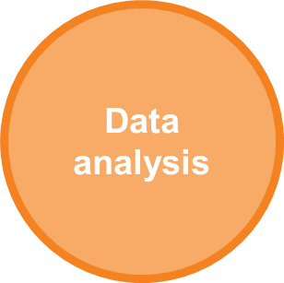
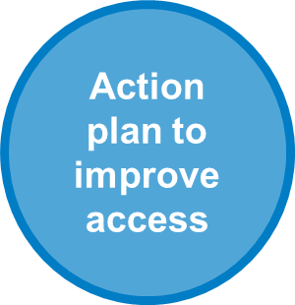
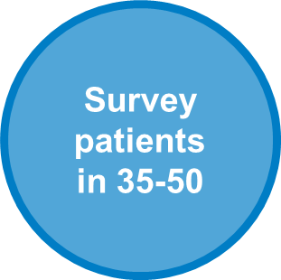
Timeline – BWM PCN
January 2020

Slide 4
Percentage of non-attenders for cervical screening – BWM PCN
Data taken from Open Exeter (January 2020)
Notes:
Key points:
National data does not match the QOF achievement data need to understand the reason for this
There is poor attendance in the age group 25-29 which will be the key group having received the HPV vaccine. Awareness raising will probably be the input required for this age group 
There appears to be a peak in non-attendance in the age range 35-44. Could this be due to lifestyle and accessibility of screening appointments?

Slide 5
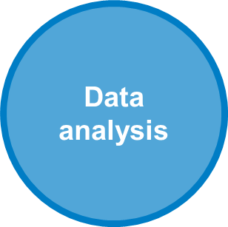
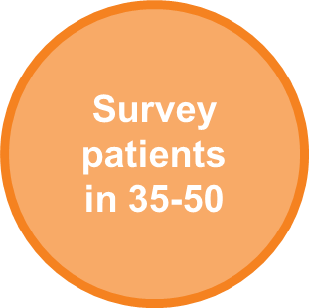
Timeline
February 2020
January 2020

Slide 6
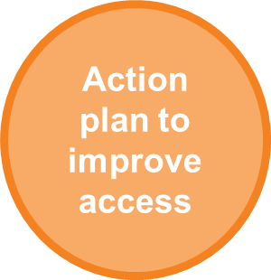
Timeline
February 2020
January 2020
February/ March 2020

Slide 7
Timeline
Data analysis
Action plan to improve access
Screening hub launched
February 2020
June 2020
January 2020
Survey patients in 35-50
February/ March 2020
Link to Extended Access

Slide 8
Timeline
Data analysis
Action plan to improve access
Screening hub launched
February 2020
June 2020
January 2020
Survey patients in 35-50
February/ March 2020
Link to Extended Access
September 2020

Slide 9
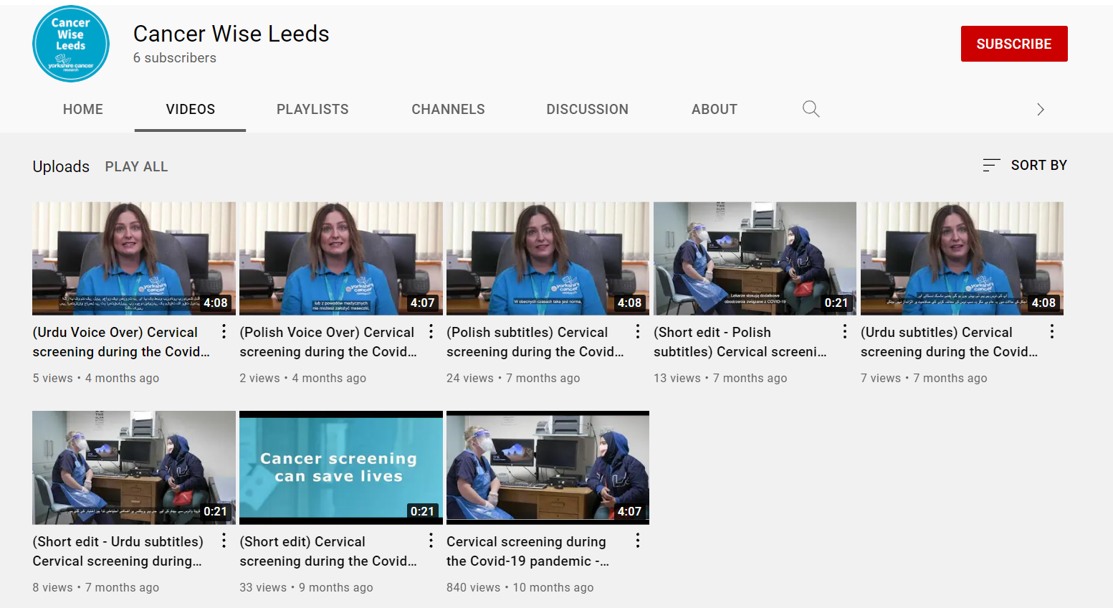

Slide 10
Cervical Screening video & comms

Slide 11
BWM cervical hub attendees – September 2020 to September 2021

Slide 12
Next steps
Cancer Wise Leeds are currently working with PCNs to look into ways in which we can utilise reception staff time during extended access clinics to support screening programmes:
Contact non responder lists for cervical screening to support lowest uptake surgeries in the PCN
Contact non responders lists for bowel screening to support lowest uptake surgeries in the PCN
Train reception staff in ‘better conversations’ so they can call patients that DNA, explain the procedure and re-book appointments

Slide 13
lisa.hammond2@nhs.net
alexandra.cocker@nhs.net

